Slide 1

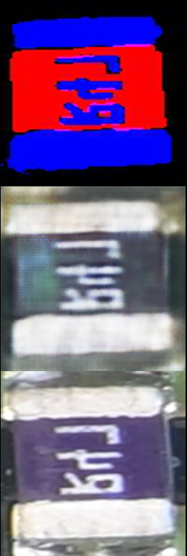
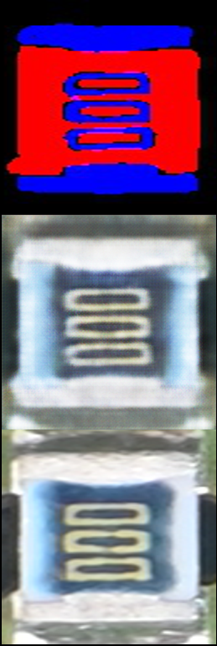
Output of training the pix2pix model
The output of Pix2pix is observed to be good on a small dataset of 40.
Input data
(Conditional)
Generated data
(Fake)
Target data
(Real)

Slide 2
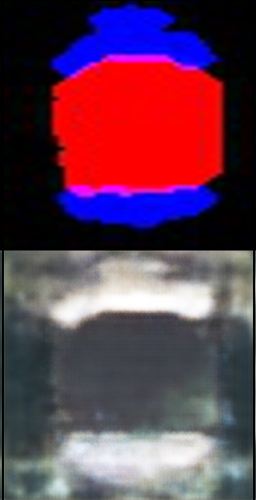
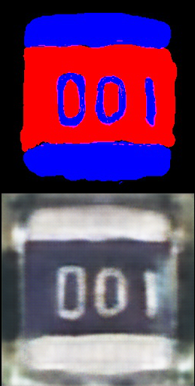

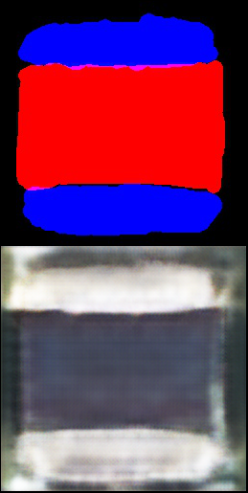

Output of the pix2pix model on the test dataset.
Test dataset is handcrafted.
Based on the trained model, the results are fine.
I expect that we can get better results if we prepare more datasets.
Input data
(Conditional)
Generated data
(Fake)

